Slide 1
Seating
Sit anywhere you find a computer with a keyboard and mouse

Slide 2
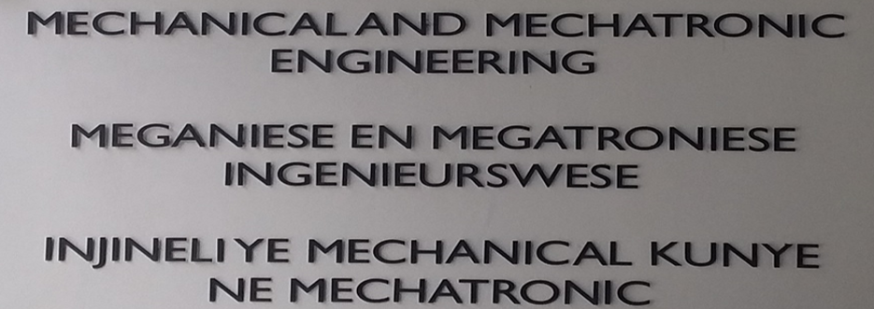
WELCOME TO FIRGA / FECUA

Slide 3
WELCOME TO FIRGA/FECUA
FAKULTEIT INGENIEURSWESE REKENAAR GEBRUIKERS AREA
FACULTY ENGINEERING COMPUTER USER AREA

Slide 4
Loadshedding
Generators available to keep
computers on and working
Printers and Projectors will
restart, and lights will switch off

Slide 5
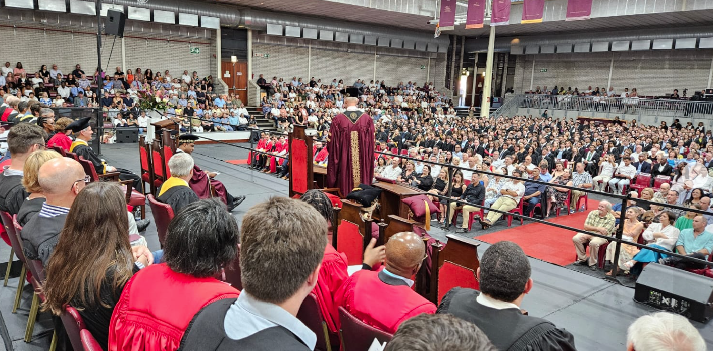
Motivation
Stephen Covey: Begin with the end in mind

Slide 6
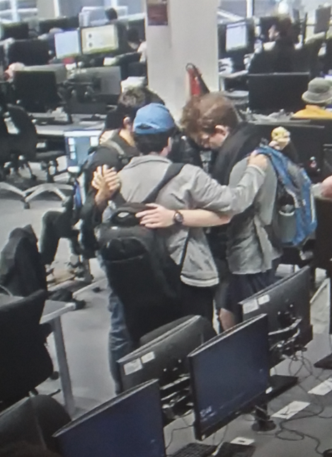
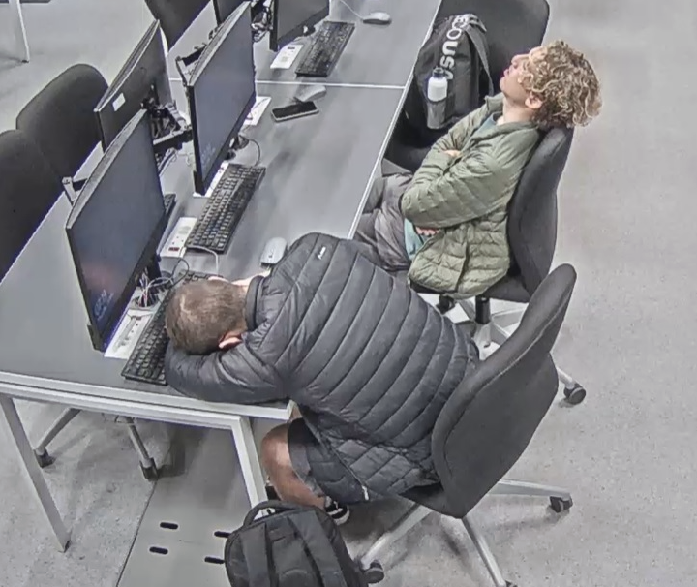
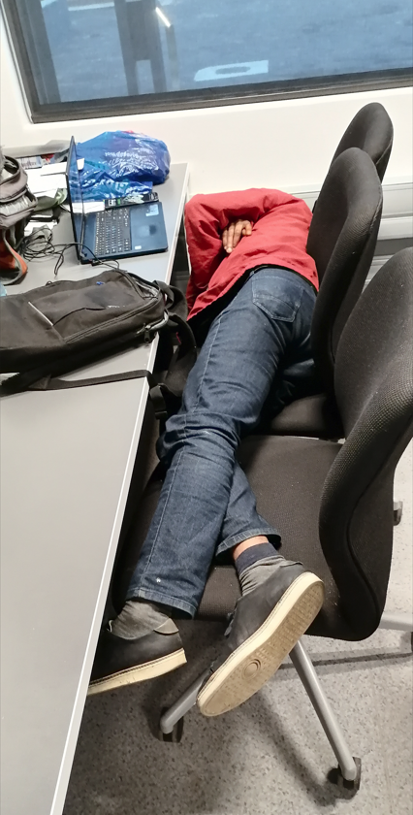
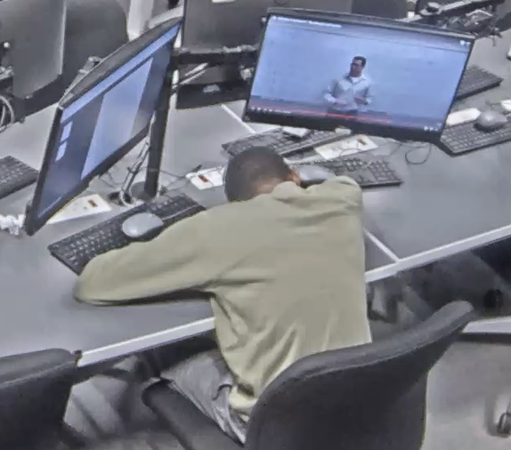
Motivation
Discipline
Sacrifice
Ask for help
Have a routine

Slide 7


Motivation
Lecturer Feedback: Students work hard to get here, but once they are here, they don’t put in the same effort
Master’s Mechanical Engineer: Work hard, don’t give up
4th year Chemical Engineer: Don’t try to do this alone, use your friends in class
4th year Student: Get enough sleep, understand fundamentals, not parrot learning (think)
4th year Student: What kept you going during 12-15 hours of study time and isolation, and getting depressed
My community and my faith (church)
My marks do not define me, but what God says about me.
Friends dragged me out and said, make some time for yourself
What is your WHY?

Slide 8
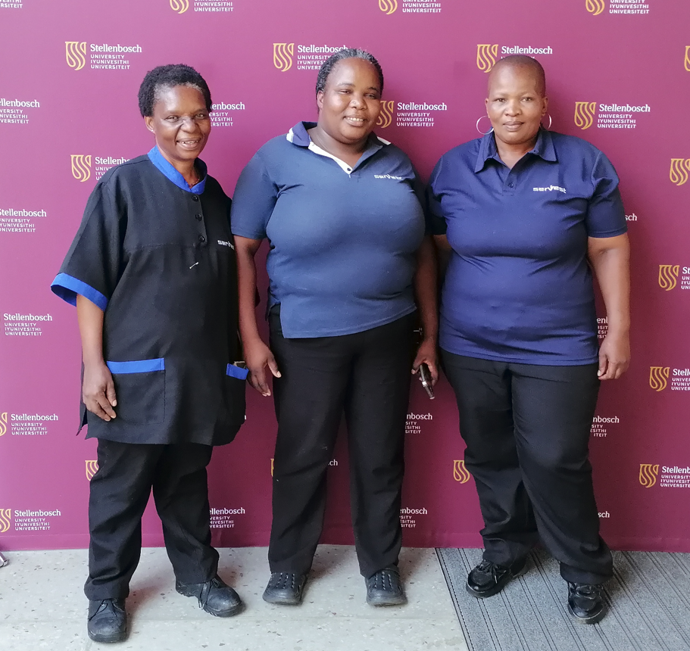
Cleaning Staff

Slide 9
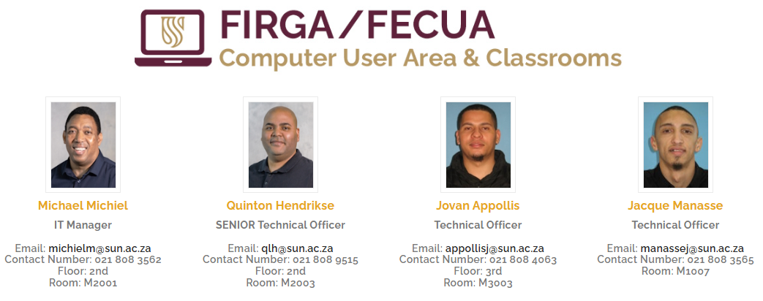
Administrative (IT) Support Staff

Slide 10
Duties
Assist the students with technology requirements
Dell Computers in our rooms
Password Resets
Printers / Load Printer Credits
Card Access
Register your personal devices
Wi-Fi Access
Lost and found items
Please ask we are here to help you

Slide 11
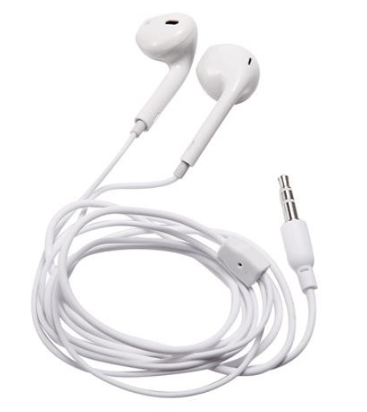
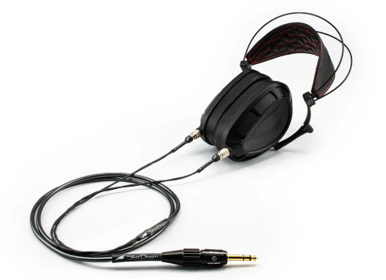

Equipment to use in our rooms
Please mark your equipment
No Bluetooth or Wireless available

Slide 12
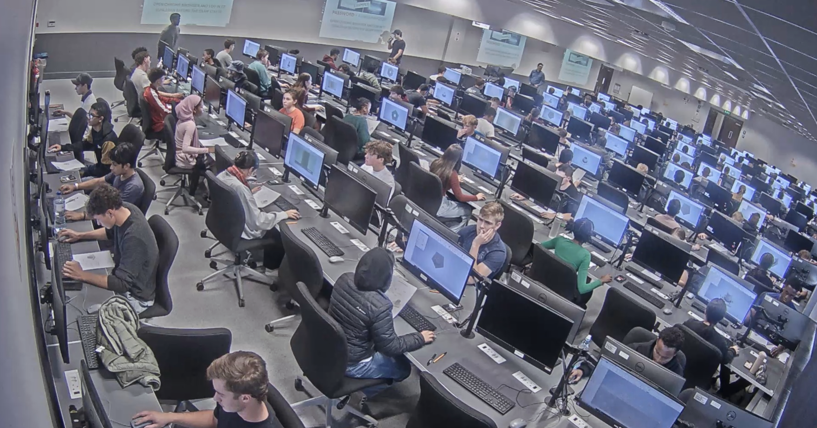
Room – M3002 (3rd Floor)
Capacity 239
Scheduled classes between 08h00 – 17h00
Can be used when the classes are done

Slide 13
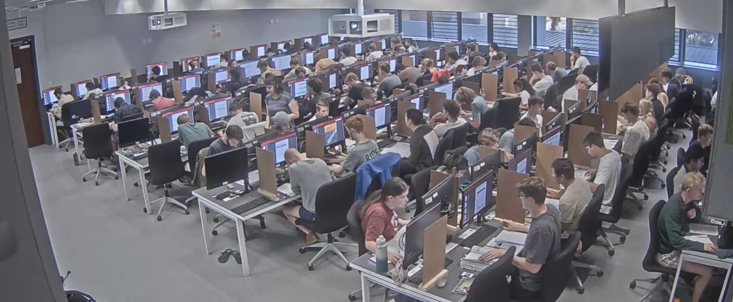
Rooms – M2002 (2nd Floor)
Capacity 118
Scheduled classes between 08h00 – 17h00
Can be used when the classes are done

Slide 14
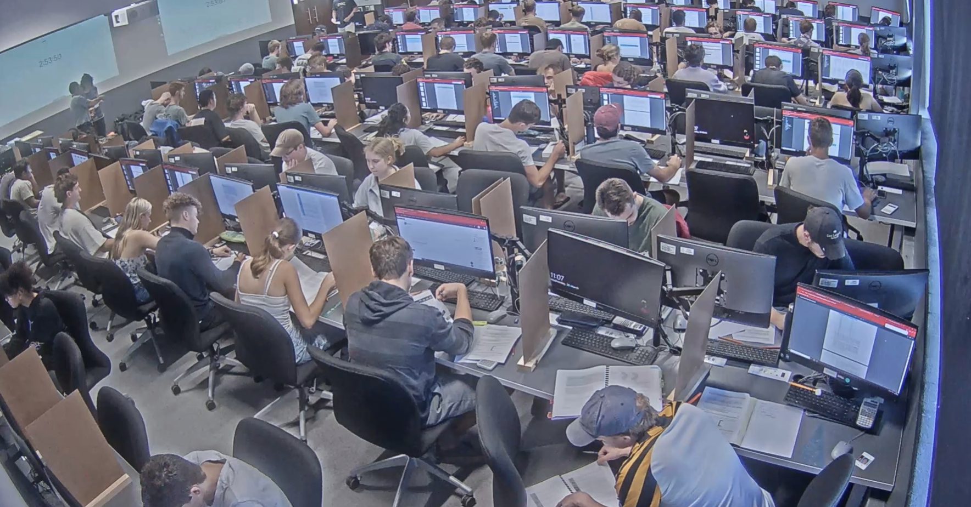
Rooms – M2004 (2nd Floor)
Capacity 115
Scheduled classes between 08h00 – 17h00
Can be used when the classes are done

Slide 15
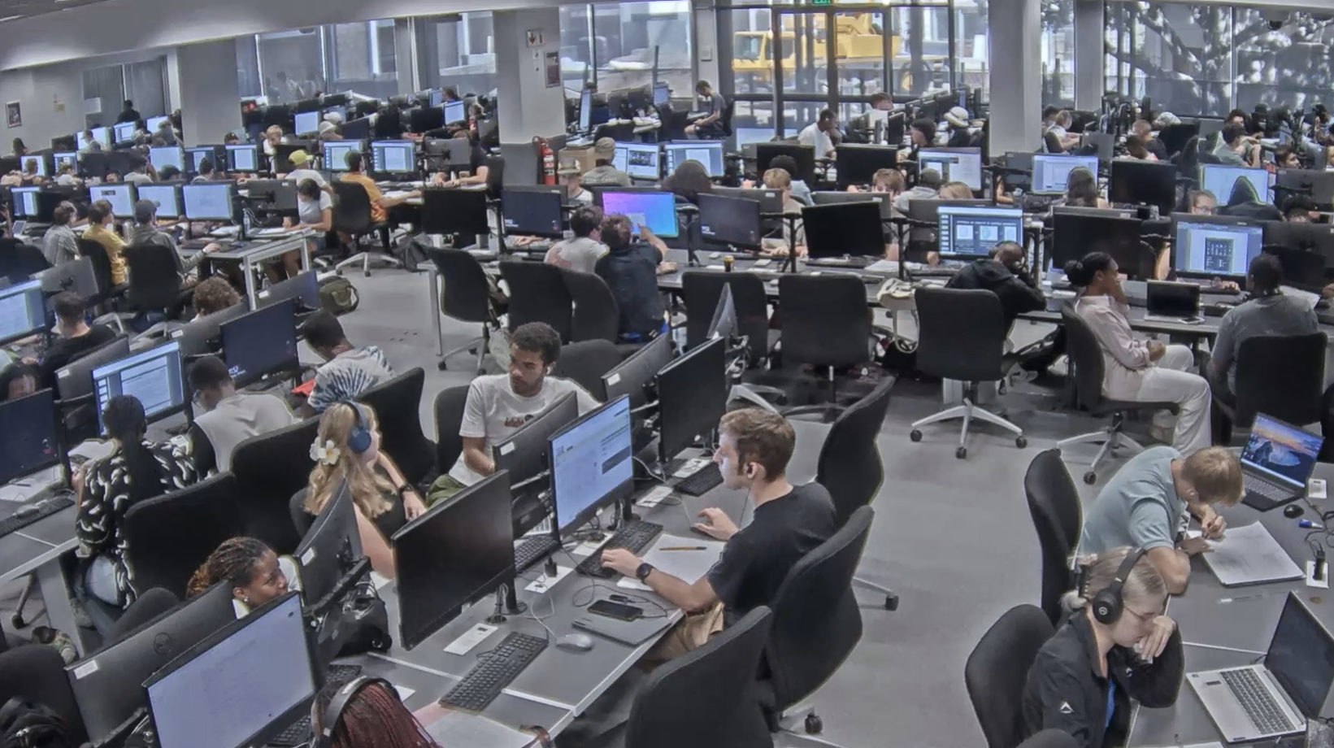
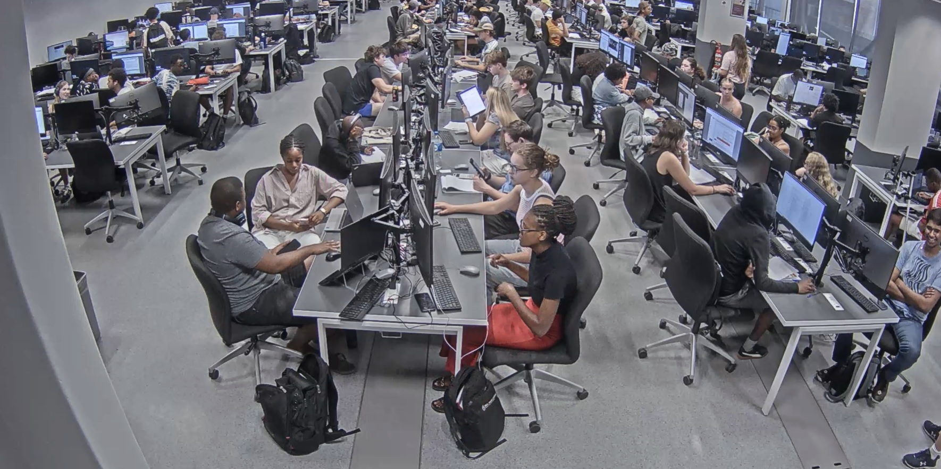
Room – M1002 (First Floor)
Capacity 300
Available for general use 24 hours a day (Work & Study Area)
No classes in this room

Slide 16
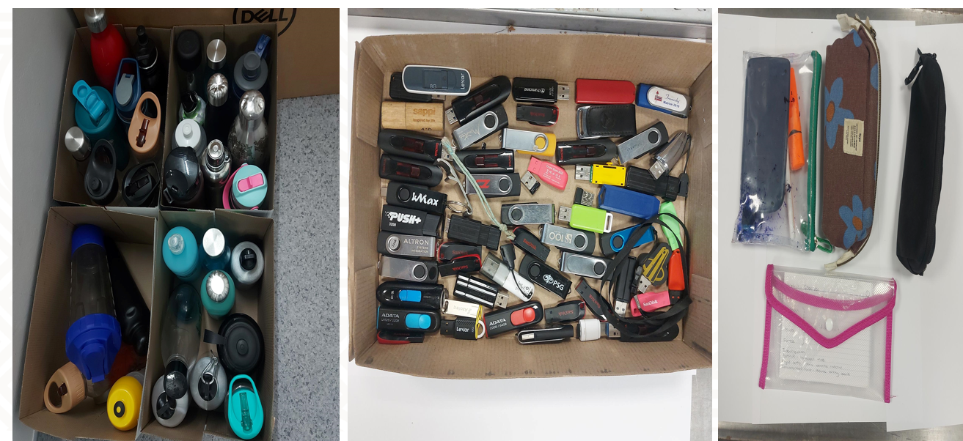
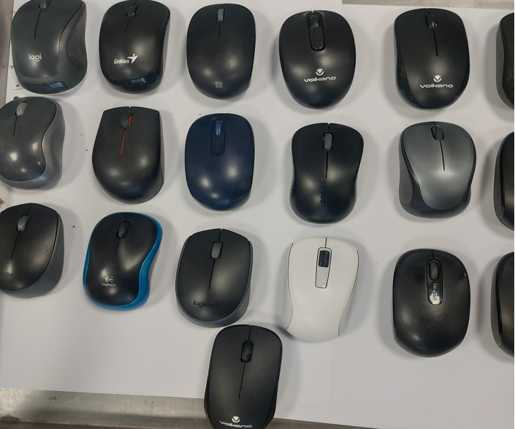
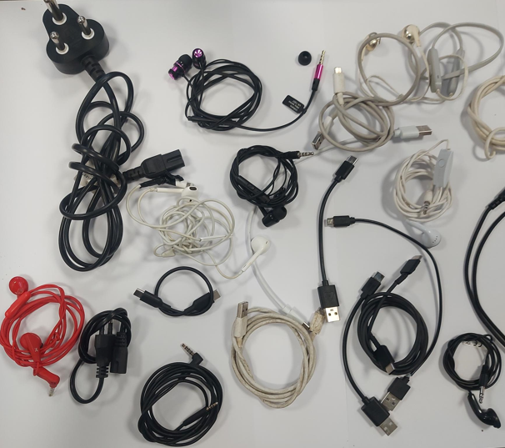
LOST AND FOUND AREA
Ask the technical officer on the 1st floor (M1007) when you forgot or left anything in the 4 rooms
We have cameras in all the areas

Slide 17
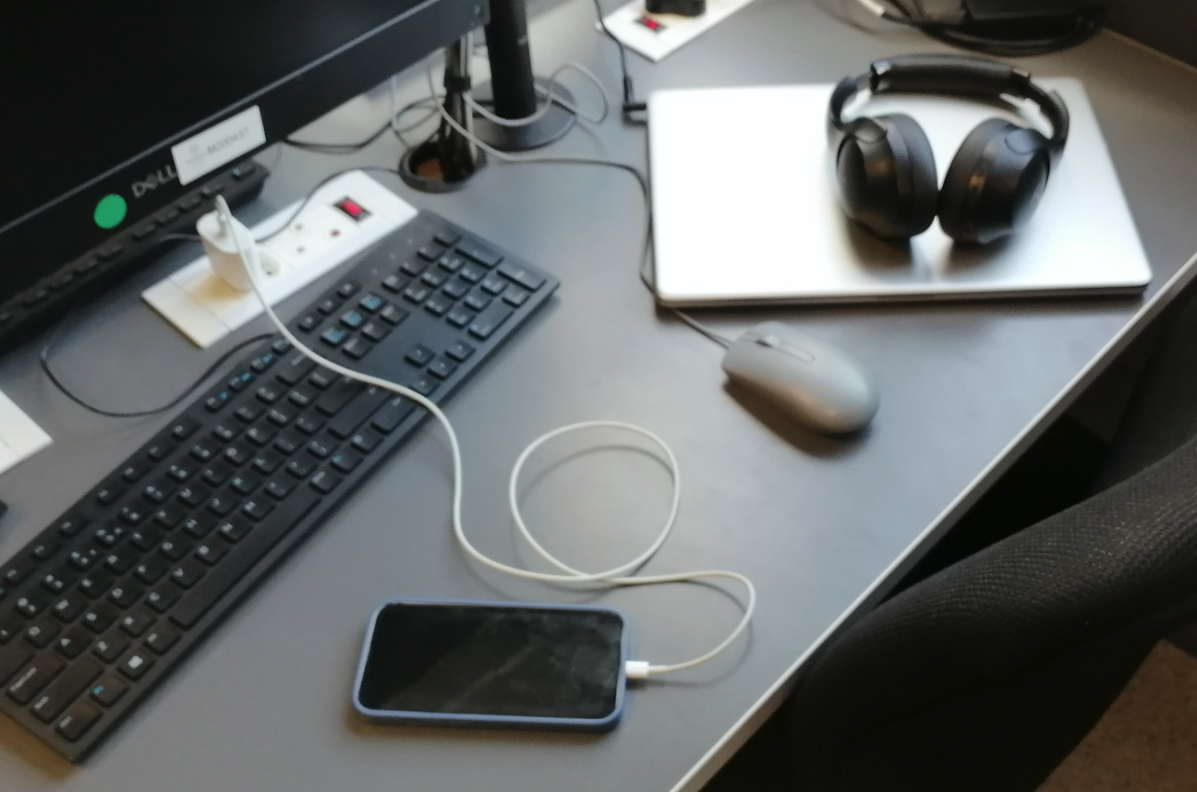
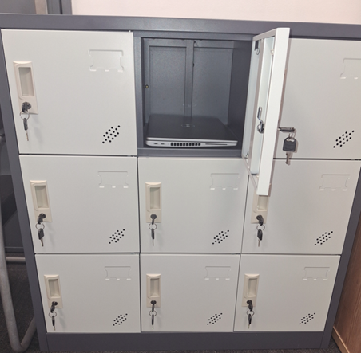
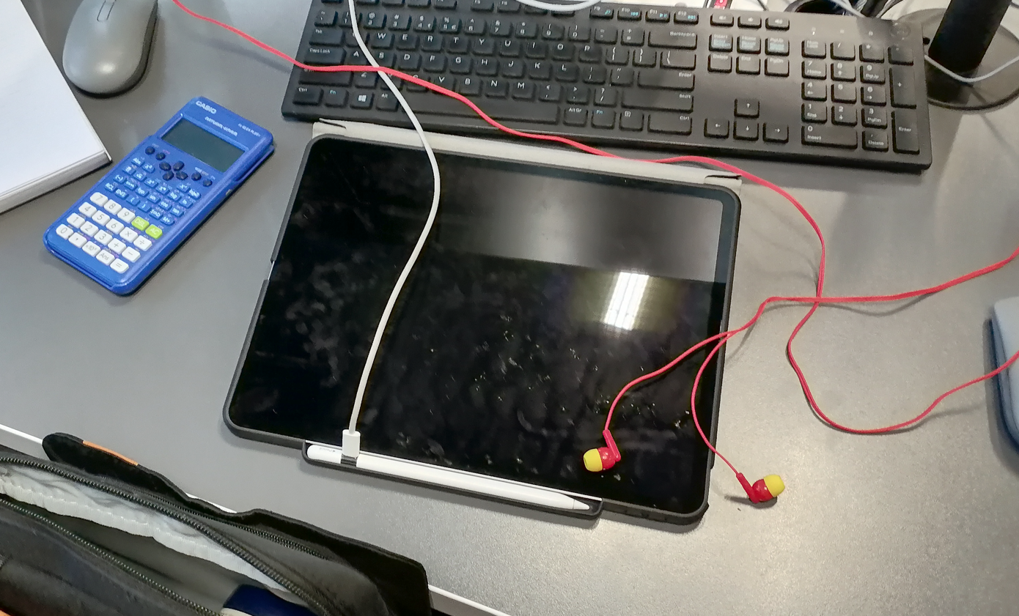
LOST AND FOUND AREA
Your responsibility to look after your items
Unattended Laptops
Cabinet in M1002 only

Slide 18
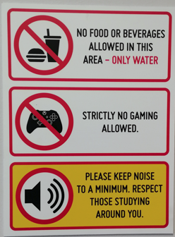

NOT ALLOWED
Respect your fellow student
Noise after hours
We have cameras in all the areas

Slide 19
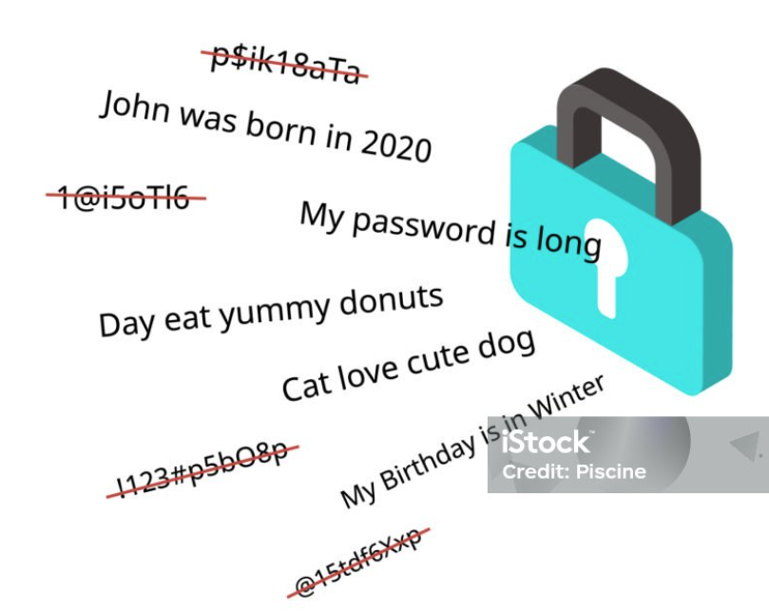
Password Management
Use a passphrase to create a
14-character password
Password expires in 1 year
Example: In2026ibecameamatie

Slide 20
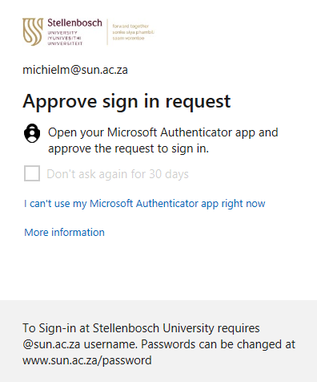
Password: Multifactor Authentication
MFA Link
MFA is compulsory to protect your identity (Sunlearn included)
(Carry your phone with you)

Slide 21
Engineering Textbook Order Facility
Faculty no longer provide the textbook ordering service to students
You are responsible to buy your own textbooks
https://firga.sun.ac.za/new-students/textbooks/

Slide 22
Home Directory and One Drive
H:Drive with 500mb available
Microsoft One Drive – 1TB
Videos: How to synchronise your files with One Drive Link
Videos: Email Management Link

Slide 23
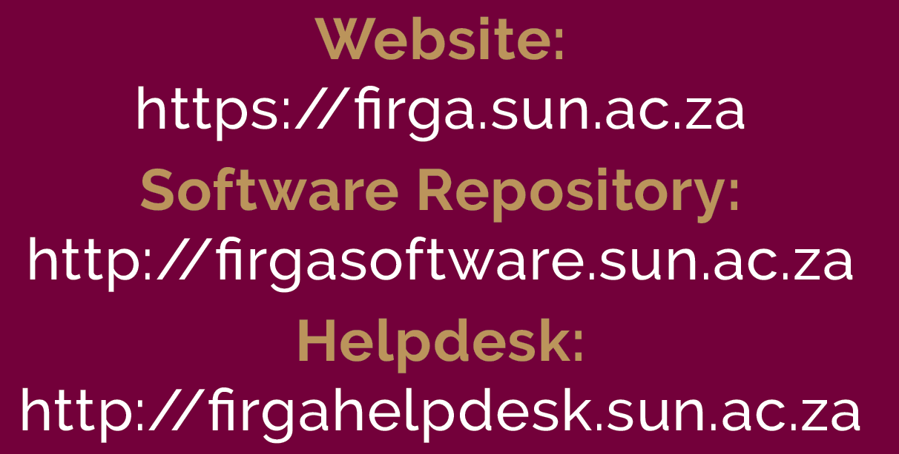
Important Links

Slide 24
Important Links
Connect to Wi-Fi: https://firga.sun.ac.za/new-students/wifi/windows-android-mac-ios/
Register your computer devices
https://dev.sun.ac.za/wiki/display/ITHUB/Wi-Fi+Connectivity
Technology Registration:
https://tech.sun.ac.za/orientation-welcoming
Multifactor Authentication Link:
https://firga.sun.ac.za/how-to-guide/#mfa

Slide 25
Summary before class starts
Have a set of headphones (with cable) when you come to the M1002 study/work area
Change your password
Make sure MFA is set up on your phone
Make sure all your devices are connected to “Eduroam”
Never save on the PC but copy your stuff on a memory stick
You have a Home Directory to save your important work on the network
Setup your Microsoft One Drive (1 TB) and file synchronisation
Load print credits for the year (R350)
Buy your books from the book supplier
You don’t pay for any of the software we make available.
Check the website 1st if still unsure ask the FIRGA Technical officers for help

Slide 26
Demo our website
https://firga.sun.ac.za/

Slide 27
Login with below details
Username: engguest
Password: Welcome2Engineering

Slide 28
Students
Keletso Mohapi (Mechanical)
Phindulo Muruba (Chemical)

Slide 29
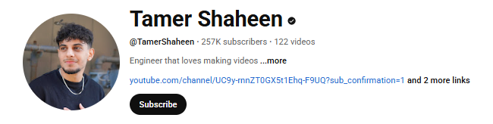
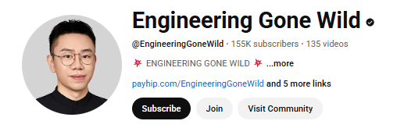
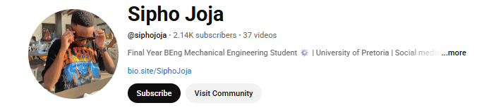
Engineering Vlog

Slide 30

Advice from a medical student who graduate – Best Study Techniques
Link: https://www.youtube.com/watch?v=UbNbKuRfW78

Slide 31
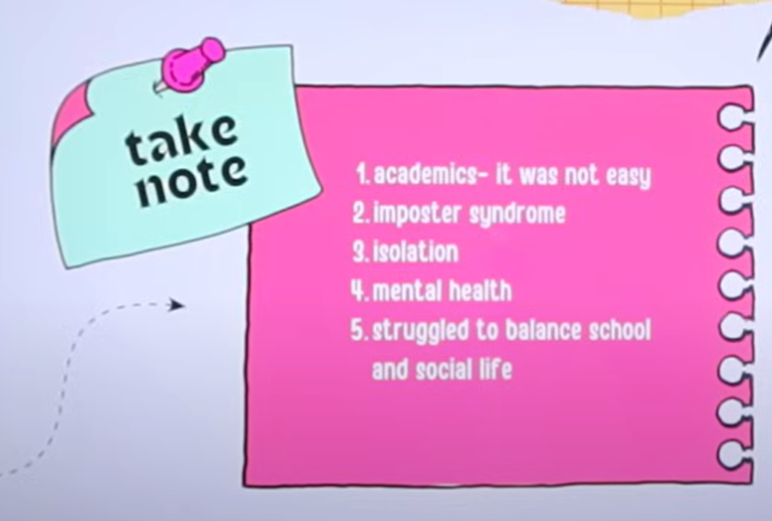
Advice from a medical student who graduate – Take Note
Link: https://www.youtube.com/watch?v=UbNbKuRfW78

Slide 32
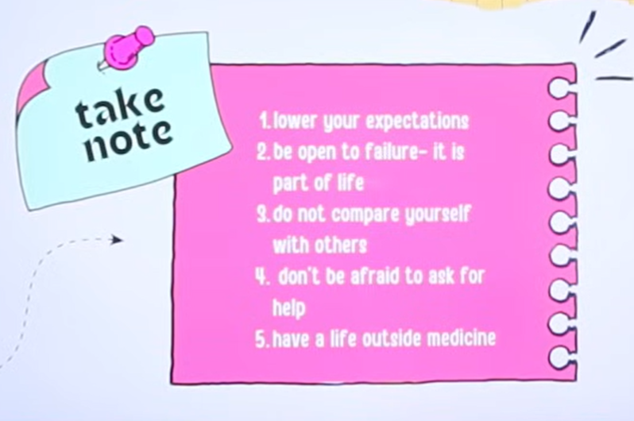
Advice from a medical student who graduate in 2024 – Take Note
Link: https://www.youtube.com/watch?v=UbNbKuRfW78

Slide 33
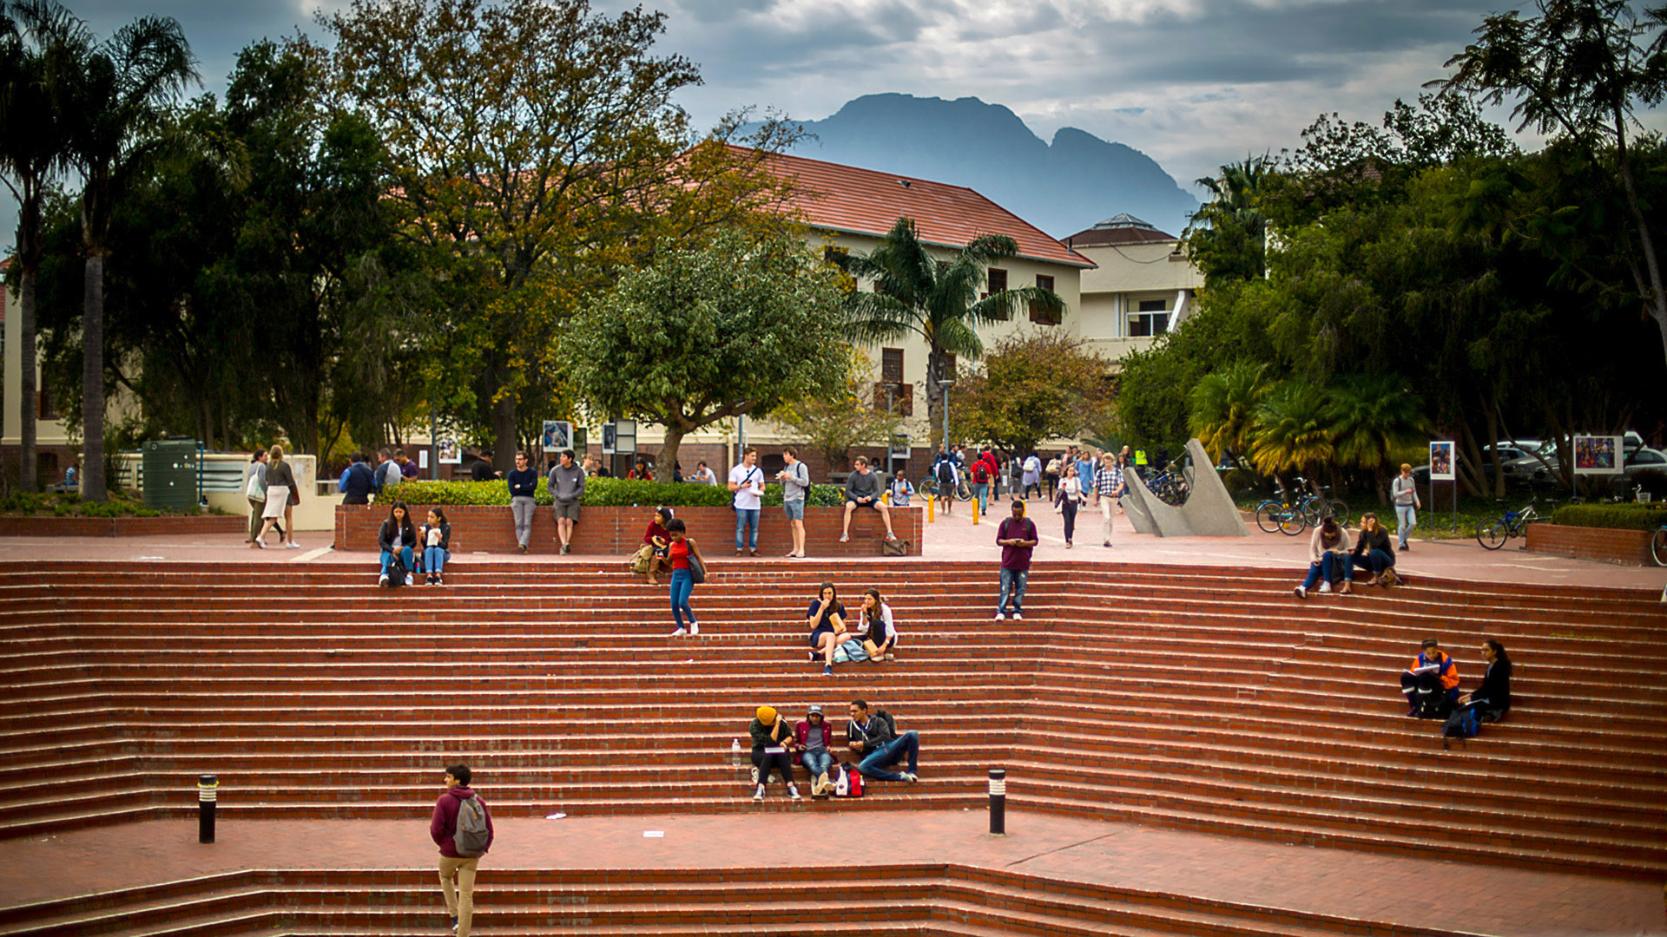
Thank you
Enkosi
Dankie
Photo by Stefan Els
Notes:
Co-branded End Slide Option
Replace the background image: Right-click on the slide, then choose Format Background and select Picture or texture fill. Select a new picture of your choice.
Remember to add an image attribution for e.g., Photo by Stefan Els.

